Slide 1
Lending Club – Case Study
Lending Club – an online agency which hosts a marketplace to mediate between investors and borrowers wants to analyse their data to minimise the risk of losing money while lending to customers.
We were offered a small subset of data between 2007 and 2011 (5 years) to identify driving factors for a profitable business model.
James Jeyabalan / Akik Ranade

Slide 2
Applicants who applied and defaulted have no significant difference in loan_amounts.
Which means that applicants applying for long term has applied for more loan.
Observations
The above analysis with respect to the charged off loans. There is a more probability of defaulting when :
Applicants taking loan for 'home improvement' and have income of 60k -70k
Applicants whose home ownership is 'MORTGAGE and have income of 60-70k
Applicants who receive interest at the rate of 21-24% and have an income of 70k-80k
Applicants who have taken a loan in the range 30k - 35k and are charged interest rate of 15-17.5 %
Applicants who have taken a loan for small business and the loan amount is greater than 14k
Applicants whose home ownership is 'MORTGAGE and have loan of 14-16k
When grade is F and loan amount is between 15k-20k
When employment length is 10yrs and loan amount is 12k-14k
When the loan is verified and loan amount is above 16k
For grade G and interest rate above 20%
Business Findings

Slide 3
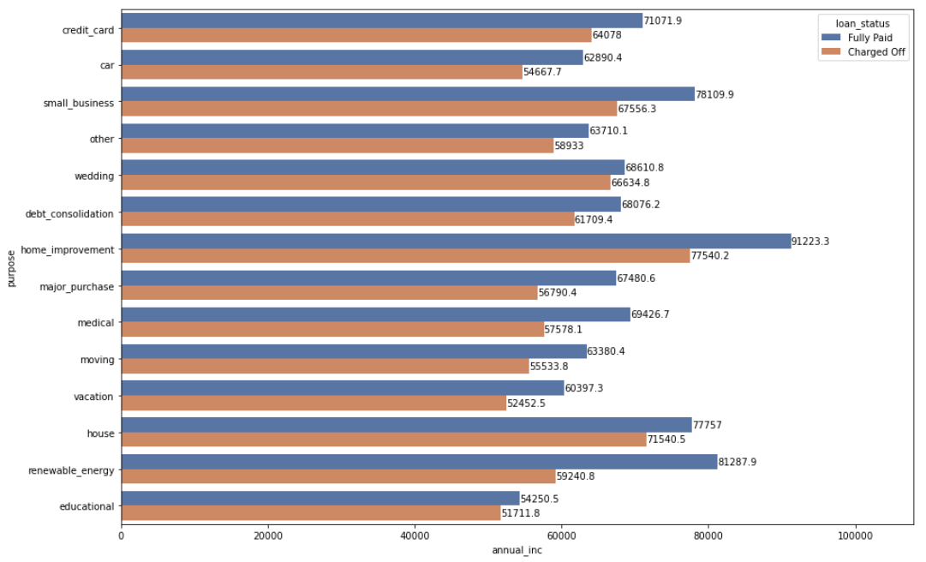
Recommendation : When borrower’s annual income is below USD 60K and the purpose is for renewable energy, there is a high chance of default

Slide 4
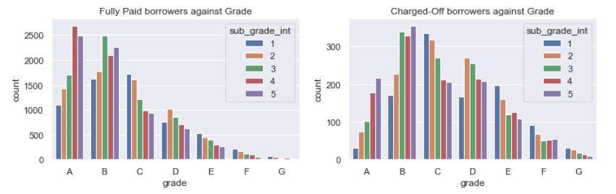
Recommendation: Grade ‘A5’ is only as good as ‘B1’ – Default percentage raises in Subgrade5 (Grade A)
“Fully Paid” Category has borrowers in grade A & B predominantly
“Charged Off” Category borrowers shift towards grade B & C

Slide 5
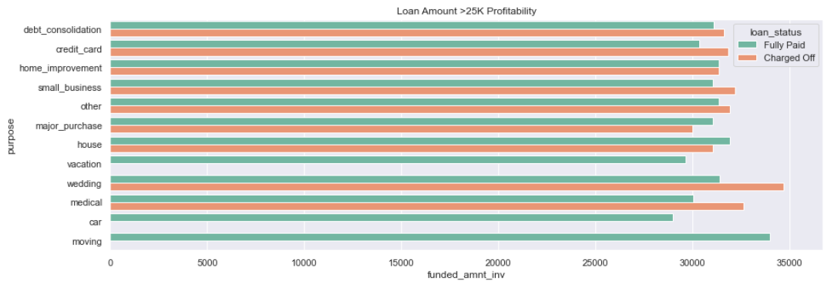
Recommendation: Wedding and Medical loans have higher default rate Vacation, Car and Moving loans have No defaulters * Considering only the loan amounts above 25K USD

Slide 6
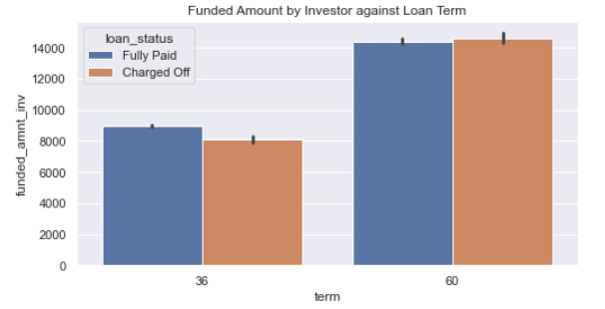
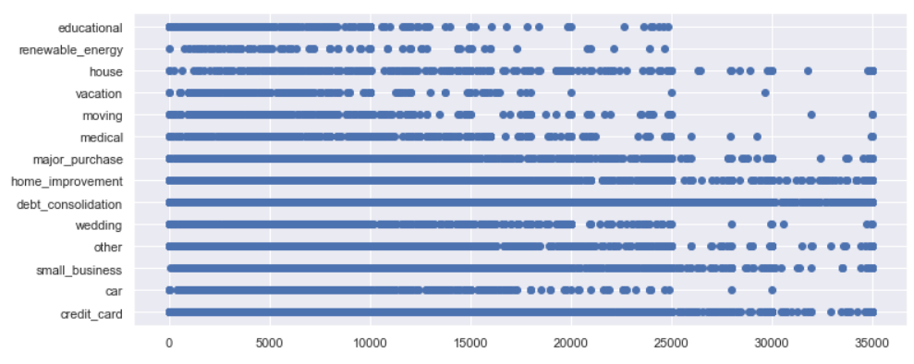
Observation – 1
Longer the term, higher the loan amount taken
a
A large portion of high loan amounts are for Debt Consolidation, Credit Card & Home Improvement
3/4th of the loans taken are for the above 3 categories

Slide 7
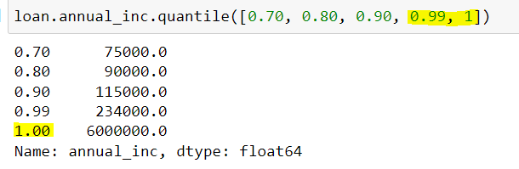
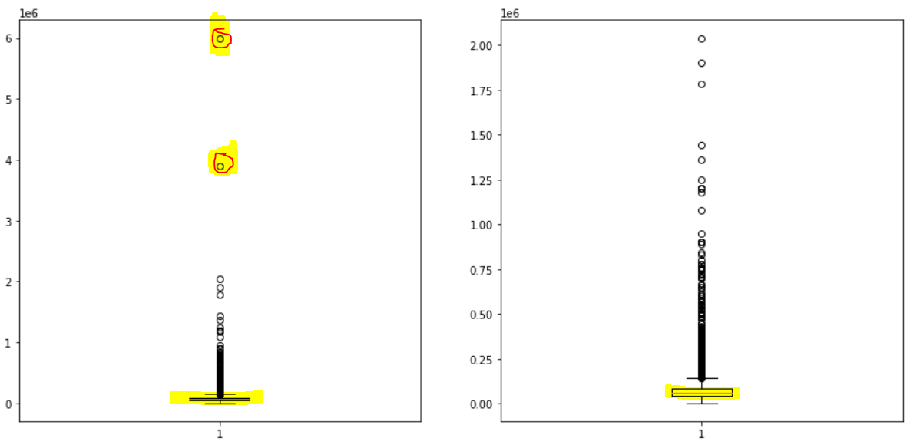
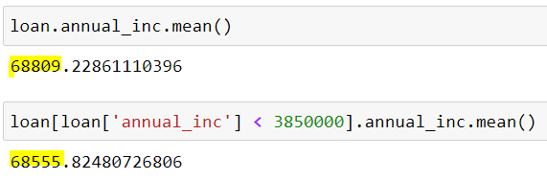
Observation - 2
There are couple of borrower's Annual Income values that are very high but it doesn't skew the mean or median. Hence those values were not considered as outliers

Slide 8
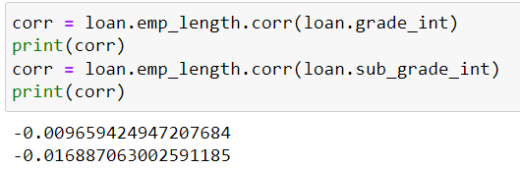
Observation – 3
There is no correlation between Borrower’s Employment period & Grade (Financial Rating)

Slide 9
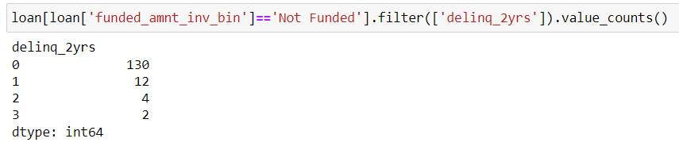
Observation – 4
Considering a subset where the investor hasn’t funded the loan, there are borrowers marked as “delinquent in the last 2 years”
These borrowers where probably funded by Lending Club
12% had defaulted (18 out of 148) in this “Lending Club Funded” category
Assumption: Since the MemberID is unique across the dataset each row is considered as a new borrower.

Slide 10
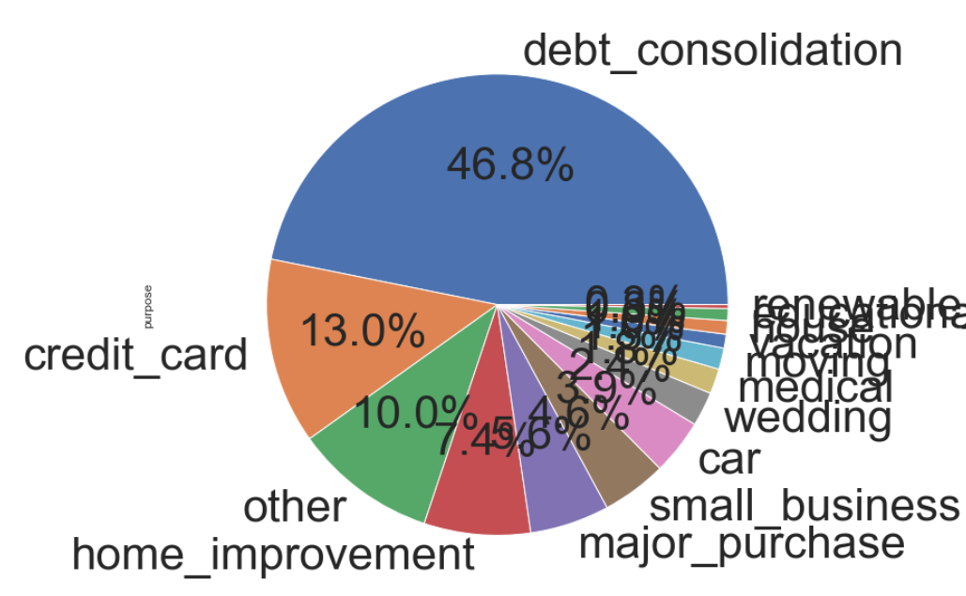
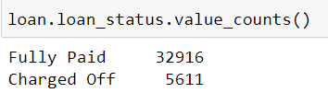
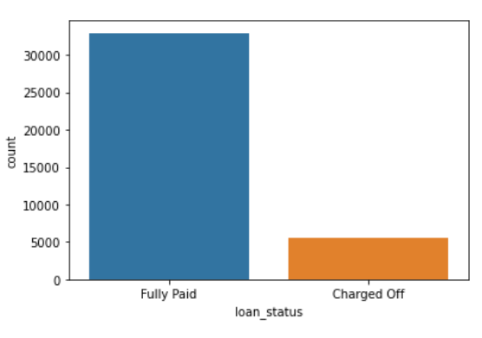
Observation – 5
Distribution of loans by “Purpose”
“Debt Consolidation” is the single largest loan purpose across “Fully Paid” and “Charged-Off” borrowers
Distribution by “Loan Status”
(after removing ‘Current’ accounts)
17% Defaulted loans

Slide 11
Raw data size (Rows: 39717, Columns: 111)
After removing “NA” columns (Columns: 57)
Effective memory utilization technique as the data set size reduced 50% (34 Mb to 17 Mb)
After removing descriptive columns (Columns: 50)
After removing uni-value columns (Columns: 41)
After removing >80% missing columns (Columns: 38)
Eliminating Current accounts as they don’t authoritatively say whether the borrower will be a defaulter or not. (Rows: 38577, 38)
# of Current accounts is 1140, of which only 121 rows show delinquency, and the last delinquency is an average 3 Years
Hence considering this subset of data has insignificant for any concrete decision and removing the “Current” loan accounts.
Remove 50 rows with ‘NA’ value for revol_util column since we don’t want to impute this ‘Ratio’ field (Rows: 38527, 38)
Remove %, + symbols, String objects which could potentially be Numeric data after removing the unwanted text suffixing the number value
Add 2 derived attributes/categories like Year/Month
Add derived metrics like ‘Annual_Installment Amount’ to ‘Annual Income’ ratio (i2i) for analysis
Add fields to dataset by casting AlphaNumeric Codes in ‘grade’, ‘subgrade’ columns as “Int” for correlation analysis
Impute Employment Length of borrower with “mode” value for ~1000 rows which have NaN
Manual Reassign Home Ownership from one bin to another to reduce the # of categories
Technical Prep
Summary

Slide 12
Thank you

